Slide 1
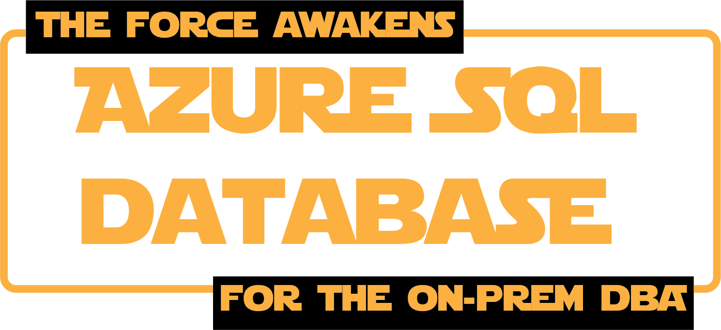

Alexander Arvidsson
@arcticdba

Slide 2











Slide 3


Copyright (C)Lucasfilm All Rights Reserved

Slide 4
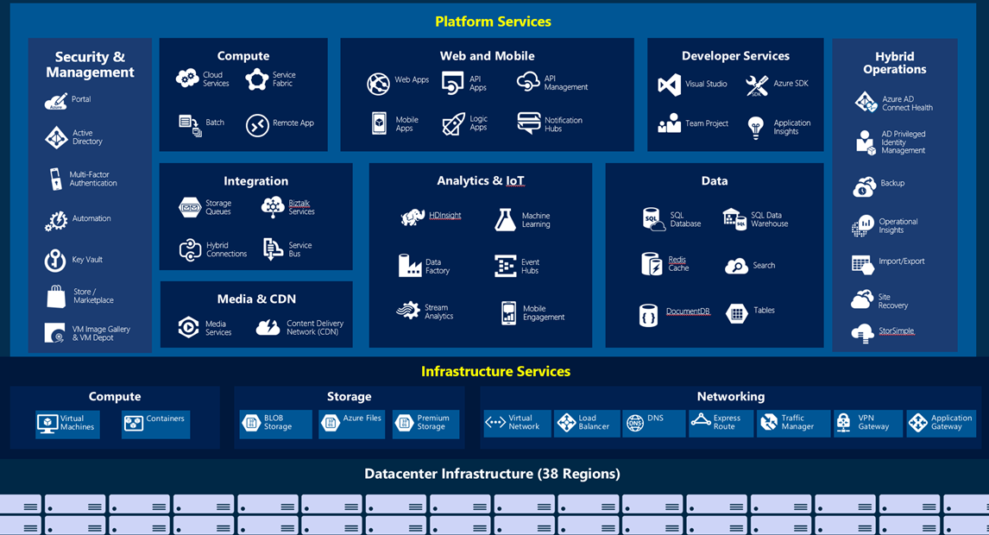

Slide 5

SQL Server on virtual machine
SQL
@arcticdba

Slide 6

Copyright (C)Lucasfilm All Rights Reserved

Slide 7





Principal solutions architect @ Atea
presenter | blogger trainer | podcaster
Star Wars fan
@arcticdba

Slide 8
Managed Instance
SQL Database (PaaS)
Singleton
SQL
Elastic
Pool
@arcticdba

Slide 9
Managed Instance
@arcticdba

Slide 10
Data Migration
Security
Programmability
Operational
Scenario Enablers
@arcticdba

Slide 11
Managed Instance
Business Critical
General Purpose
8/16/24/32/40 vCores
4TB super-fast local SSD
8/16/24/32/40 vCores
35TB remote disk
@arcticdba

Slide 12
Managed Instance
SQL Database (PaaS)
Singleton
SQL
Elastic
Pool
@arcticdba

Slide 13
Elastic
Pool
Singleton
@arcticdba

Slide 14
800x
Basic
Standard
Premium
B – 5 DTU
S0 – 10 DTU
…
S12 – 3000 DTU
P1 – 125 DTU
…
P15 – 4000 DTU

Slide 15
Customer 1
Customer 2
Customer N
Basic | Standard | Premium
1,600 | 3,000 | 4,000
@arcticdba

Slide 16

DTU
vCore
https://docs.microsoft.com/sv-se/azure/sql-database/sql-database-benchmark-overview
@arcticdba

Slide 17
Migration
Installation
Performance monitoring
Maintainance
Configuration
Capacity planning
High availability
Upgrade
Troubleshooting
Backup / recovery
@arcticdba

Slide 18
Installation
Performance monitoring
Configuration
Troubleshooting
High availability
Backup / recovery
Capacity planning
Migration
Maintenance
Upgrade
@arcticdba

Slide 19
Installation
Performance monitoring
Configuration
Troubleshooting
High availability
Backup / recovery
Capacity planning
Migration
Maintenance
Upgrade
@arcticdba

Slide 20
High availability
Backup / recovery
@arcticdba

Slide 21
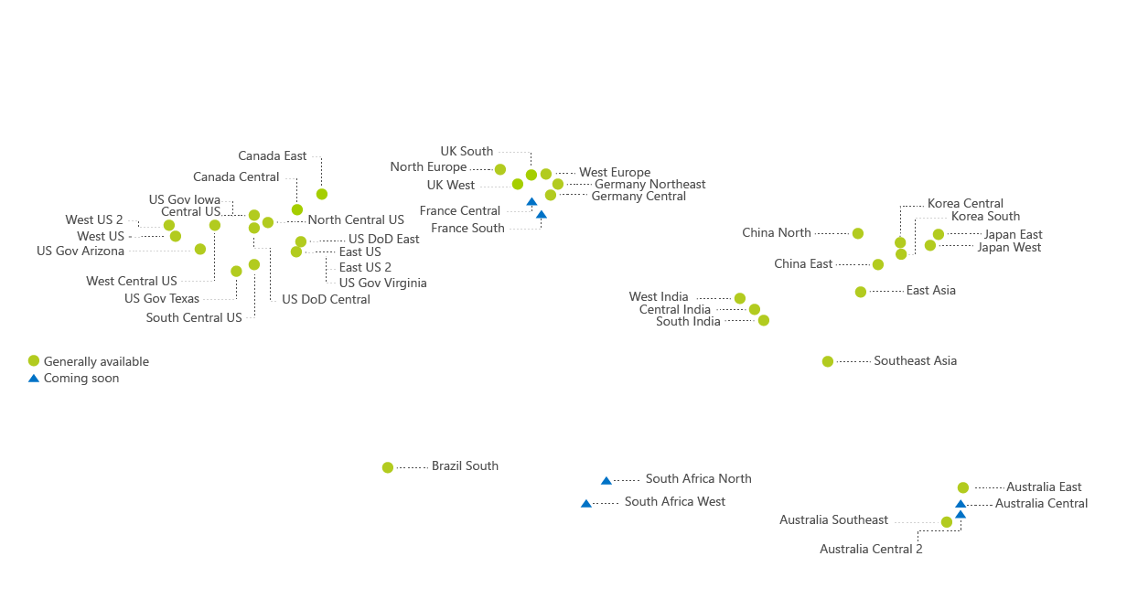

Slide 22
Performance monitoring
Troubleshooting
@arcticdba

Slide 23
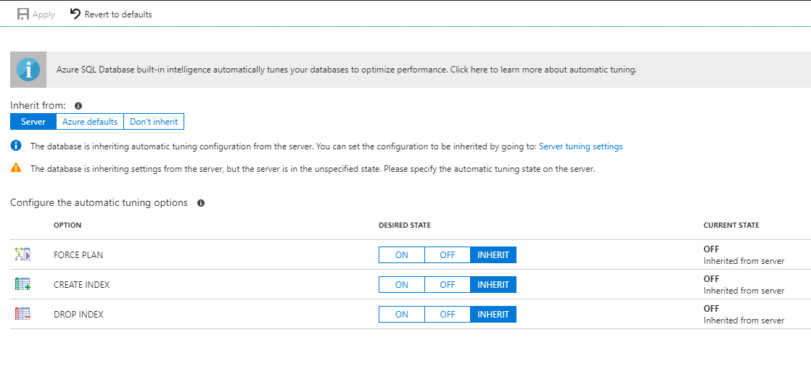

Slide 24
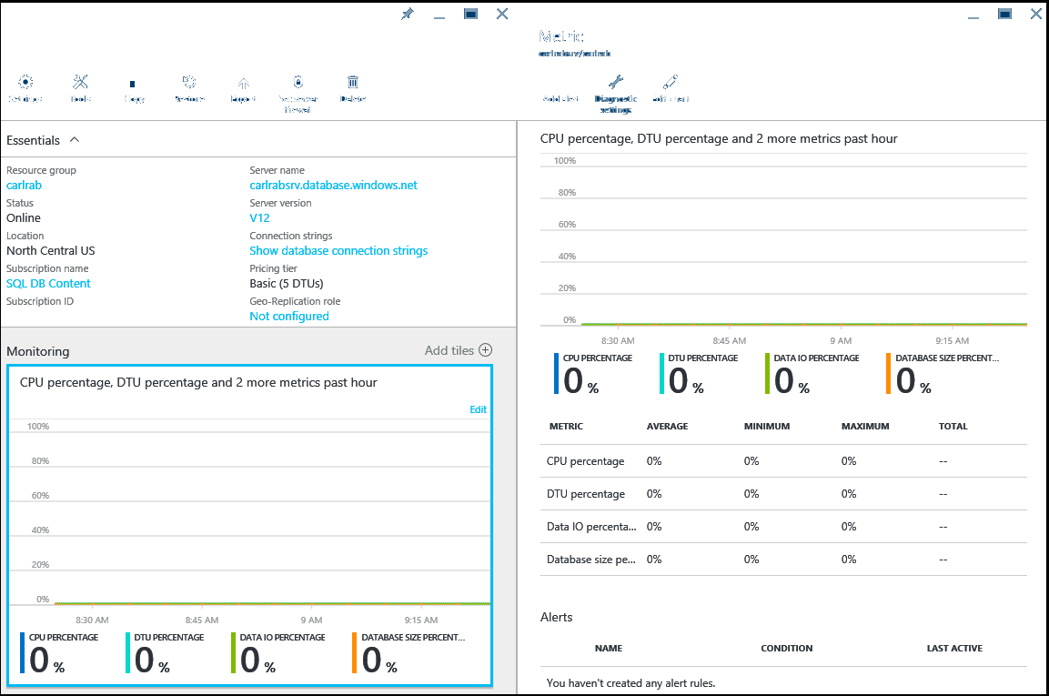

Slide 25
Maintenance
@arcticdba

Slide 26
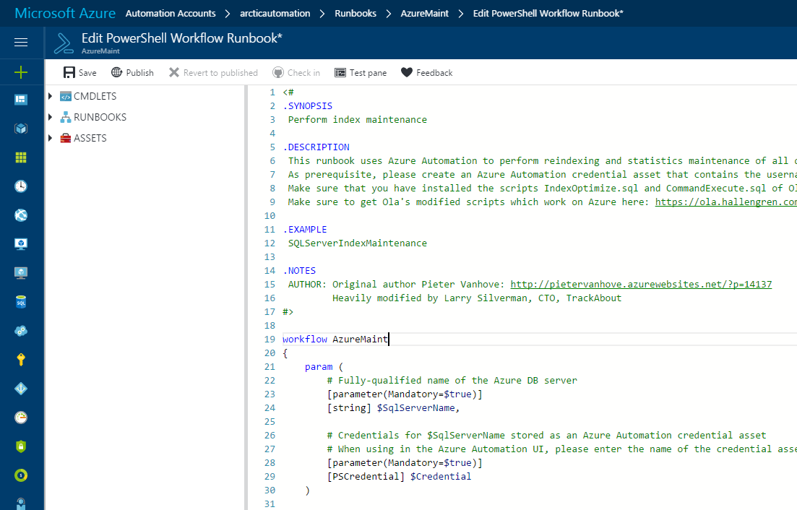

Slide 27
Capacity planning
@arcticdba

Slide 28
Migration
@arcticdba

Slide 29
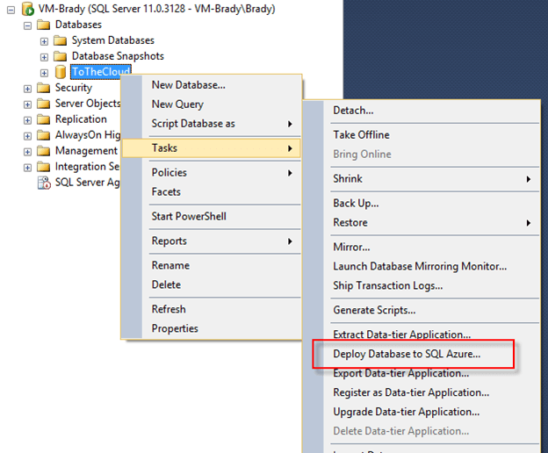

@arcticdba

Slide 30


Copyright (C)Lucasfilm All Rights Reserved

Slide 31
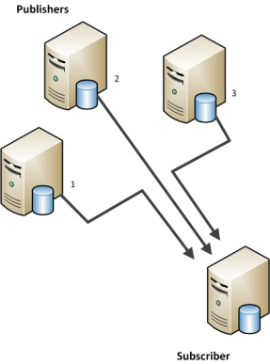




@arcticdba

Slide 32

Good, good things with
Azure SQL Server
Copyright (C)Lucasfilm All Rights Reserved

Slide 33
Elasticity
Simplified administration
Automation
No upfront costs
Integration
ATP
@arcticdba

Slide 34

Not so good things with
Azure SQL Server
Copyright (C)Lucasfilm All Rights Reserved

Slide 35
Price
Performance
Often requires redesign
Latency
Featureset
Automation
@arcticdba

Slide 36
Are you asking the right question?
@arcticdba

Slide 37
Assumption is the mother of all f*ckups
@arcticdba

Slide 38
Capitalize on the opportunities
@arcticdba

Slide 39
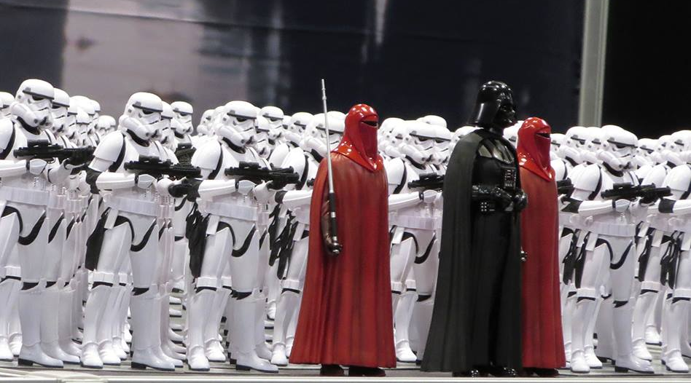
?
?

Slide 40

Alexander Arvidsson
alexander.arvidsson@atea.se
alexander@arcticdba.se
@arcticdba
Copyright (C)Lucasfilm All Rights Reserved
Copyright (C)Lucasfilm All Rights Reserved

